Slide 1
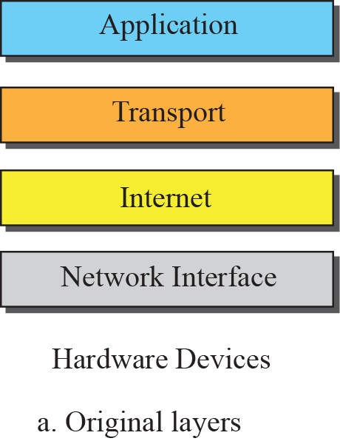
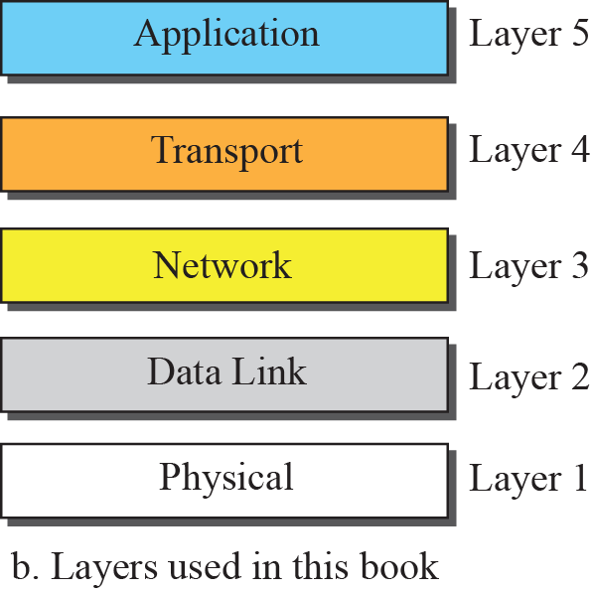
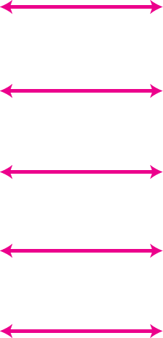
Layers in the TCP/IP Protocol Suite

Slide 2
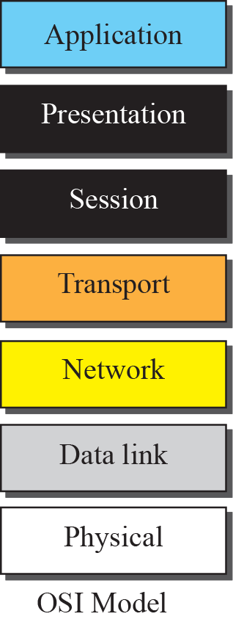
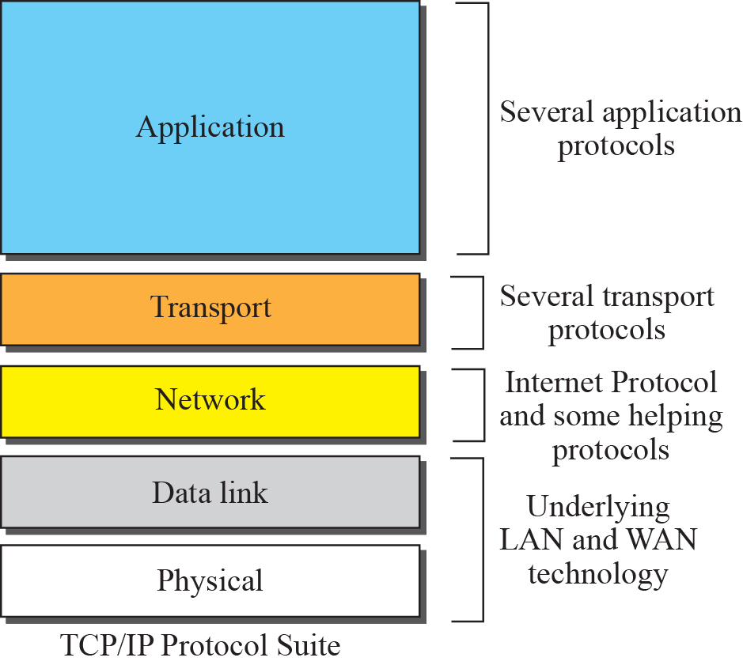
Figure 2.8 TCP/IP and OSI model

Slide 3
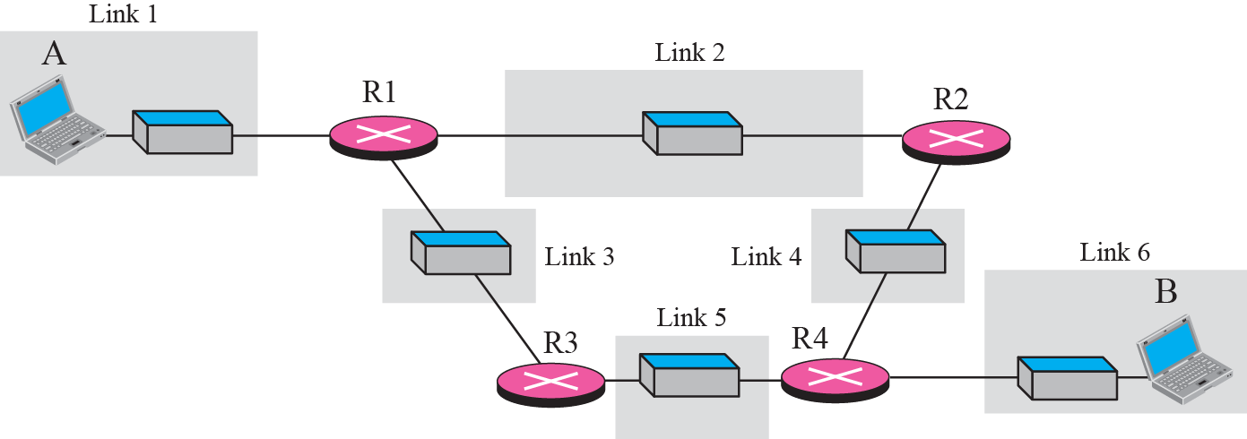
Figure 2.9 A private internet

Slide 4
Figure 2.10 Communication at the physical layer

Slide 5

Note
The unit of communication at the physical layer is a bit.

Slide 6
Figure 2.11 Communication at the data link layer

Slide 7
Note
The unit of communication at the data link layer is a frame.

Slide 8
Figure 2.12 Communication at the network layer

Slide 9
Note
The unit of communication at the network layer is a datagram.

Slide 10
Figure 2.13 Communication at transport layer

Slide 11
Note
The unit of communication at the transport layer is a segment, user datagram, or a packet, depending on the specific protocol used in this layer.

Slide 12
Figure 2.14 Communication at application layer

Slide 13
Note
The unit of communication at the application layer is a message.

Slide 14
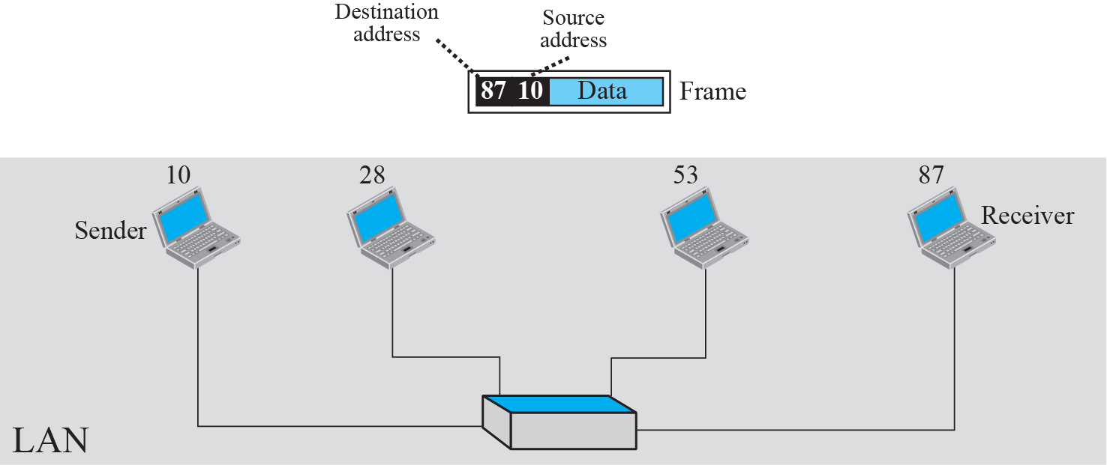
Figure 2.16 Example 2.3: physical addresses

Slide 15
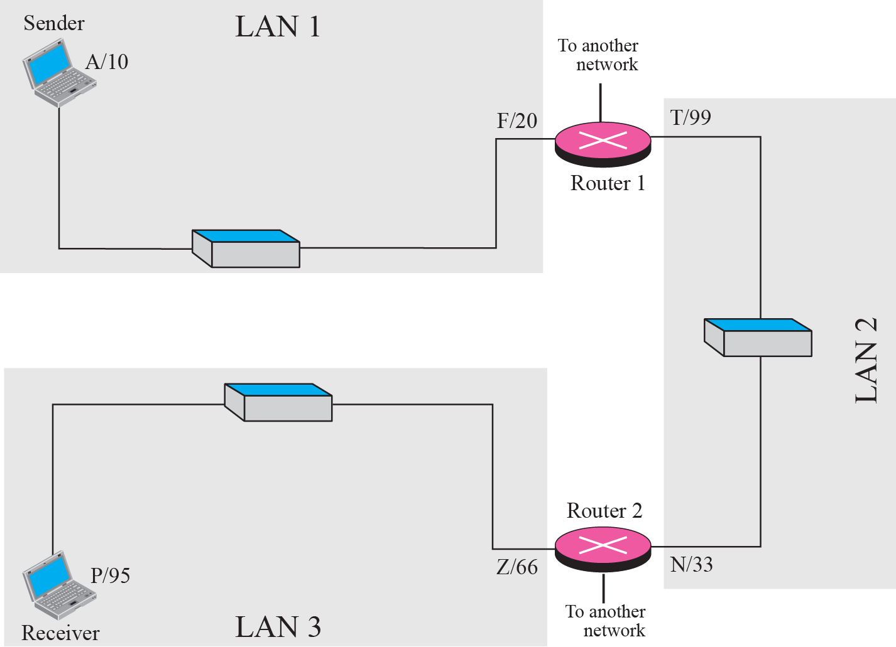
Figure 2.17 Example 2.5: logical addresses

Slide 16
Note
The physical addresses will change from hop to hop, but the logical addresses remain the same.

Slide 17
Note
The physical addresses change from hop to hop, but the logical and port addresses usually remain the same.

Slide 18
TCP/IP protocol family
IP : Internet Protocol
UDP : User Datagram Protocol
RTP, traceroute
TCP : Transmission Control Protocol
HTTP, FTP, ssh

Slide 19
What is an internet?
A set of interconnected networks
The Internet is the most famous example
Networks can be completely different
Ethernet, ATM, modem, …
(TCP/)IP is what links them

Slide 20
What is an internet? (cont)
Routers (nodes) are devices on multiple networks that pass traffic between them
Individual networks pass traffic from one router or endpoint to another
TCP/IP hides the details as much as possible

Slide 21
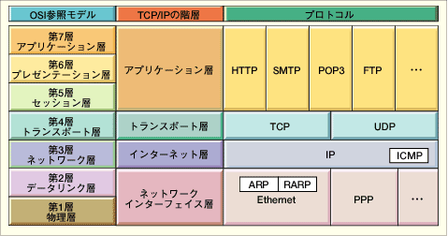
OSI and Protocol Stack
OSI: Open Systems Interconnect
OSI Model
TCP/IP Hierarchy
Protocols
7th
Application Layer
6th
Presentation Layer
Application Layer
5th
Session Layer
4th
Transport Layer
Transport Layer
3rd
Network Layer
Network Layer
2nd
Link Layer
Link Layer
1st
Physical Layer
Link Layer : includes device driver and network interface card
Network Layer : handles the movement of packets, i.e. Routing
Transport Layer : provides a reliable flow of data between two hosts
Application Layer : handles the details of the particular application

Slide 22
TCP
Reliable, full-duplex, connection-oriented, stream delivery
Interface presented to the application doesn’t require data in individual packets
Data is guaranteed to arrive, and in the correct order without duplications
Or the connection will be dropped
Imposes significant overheads

Slide 23
Applications of TCP
Most things!
HTTP, FTP, …
Saves the application a lot of work, so used unless there’s a good reason not to

Slide 24
TCP implementation
Connections are established using a three-way handshake
Data is divided up into packets by the operating system
Packets are numbered, and received packets are acknowledged
Connections are explicitly closed
(or may abnormally terminate)

Slide 25
TCP Packets
Source + destination ports
Sequence number (used to order packets)
Acknowledgement number (used to verify packets are received)

Slide 26
Internet Protocol
IP is the network layer
packet delivery service (host-to-host).
translation between different data-link protocols
IP provides connectionless, unreliable delivery of IP datagrams.
Connectionless: each datagram is independent of all others.
Unreliable: there is no guarantee that datagrams are delivered correctly or even delivered at all.

Slide 27
IP Addresses
IP addresses are not the same as the underlying data-link (MAC) addresses.
IP is a network layer - it must be capable of providing communication between hosts on different kinds of networks (different data-link implementations).
The address must include information about what network the receiving host is on. This is what makes routing feasible.
Why ?

Slide 28
IP
Responsible for end to end transmission
Sends data in individual packets
Maximum size of packet is determined by the networks
Fragmented if too large
Unreliable
Packets might be lost, corrupted, duplicated, delivered out of order

Slide 29
IP addresses
4 bytes
e.g. 163.1.125.98
Each device normally gets one (or more)
In theory there are about 4 billion available
But…

Slide 30
Routing
How does a device know where to send a packet?
All devices need to know what IP addresses are on directly attached networks
If the destination is on a local network, send it directly there

Slide 31
Routing (cont)
If the destination address isn’t local
Most non-router devices just send everything to a single local router
Routers need to know which network corresponds to each possible IP address

Slide 32
TCP : Data transfer
Client
Host
Send Packet 1
Start Timer
Packet Lost
Timer
Packet should arrive
ACK should be sent
ACK would normally
Arrive at this time
Time Expires
Retransmit Packet1
Start Timer
Timer
Receive Packet 1
Send AXK 1
Receive ACK 1
Cancel Timer

